Slide 1
Notices, Announcements, and Invitations
Week 12

Slide 2
Key Components of a Notice:
Header: Date, time, place (if applicable)-
Title: Clear and concise
Body: Brief and to the point
Signature: Issuer’s name and position
Example:

Slide 3
Job Fair Notice
Date: December 5,2024
Time:10:00 AM-3:00 PM
Location: Student Union Ballroom
Attention: Senior Undergraduates and Second-Year Graduate Students
You are cordially invited to the University Job Fair. Please dress in business formal attire and bring multiple copies of your resume for on-site interviews.
RSVP:[email protected]by November 25,2024.
Don't miss this opportunity to connect with potential employers and kickstart your career.
See you there!
Career Services Office

Slide 4
写作题目：通知
主题：图书馆临时闭馆通知
日期：2024年11月28日
致：全体师生
来自：学校图书馆
请根据以上信息，撰写一份简短的通知，告知师生图书馆因内部装修将临时闭馆的事宜。要求通知内容简洁明了，包含闭馆的具体日期和预计重新开放的时间，以及对师生可能带来的不便表示歉意。字数控制在80个单词左右。

Slide 5
Notice
:Subject:Temporary Library Closure
Date:November 28,2024
To:All Faculty and Students
From:School Library
Dear All,
The library will be closed from December 1st to 7th for renovation. We apologize for any inconvenience this may cause and appreciate your understanding. Reopening is scheduled for December 8th.
Sincerely,
School Library

Slide 6
Definition of an Announcement
An announcement is a public declaration of information or news.
Purpose: To share information with a wide audience, often for a specific event or occasion.
Examples: New product launches, job openings, community events.

Slide 7
Key Components of an Announcement
Header: Date, time, place (if applicable)
Title: Attention-grabbing and relevant-
Body: Detailed information, including who, what, when, where, why, and how (the 5 Ws + H)
Contact Information: For further inquiries

Slide 8
Announcement
Subject: New Campus Library Hours
Date: November 25,2024
Dear Students and Faculty,
Effective immediately, the campus library will extend its hours to better accommodate study needs. The new schedule is Monday through Friday,8 AM to 10 PM, and Saturday,10 AM to 6 PM. Please take advantage of the additional hours to enhance your academic success. For more information, visit the library website or inquire at the circulation desk.
Thank you for your cooperation.
Library Administration

Slide 9
Exercise: rewrite the following notice

Slide 10
University Job Fair Notice
Date:December 5,2024Time:10:00 AM-3:00 PM
Location:University Student Union Ballroom
To:All Senior Undergraduate Students and Second-Year Graduate Students
Subject:Invitation to the Annual University Job Fair
Dear Students,
We are pleased to announce the upcoming Annual University Job Fair, an exclusive event designed to connect our top-performing students with leading employers from various industries. This event is a prime opportunity for you to make a strong impression and secure your future career.
Details of the Event:• Date&Time:December 5,2024,from 10:00 AM to 3:00 PM•
Venue:University Student Union Ballroom•
Dress Code:Business Formal(Suit and Tie)•
Requirements:All attendees must bring multiple copies of their resumes and be prepared for on-site initial interviews.
Key Highlights:• Direct interaction with recruiters from top companies
.• Opportunities for immediate job offers and internships
.• Seminars on effective resume writing and interview techniques.•
Networking sessions to expand your professional circle.
Dress Code and Preparation:• It is mandatory for all participants to adhere to the business formal dress code.. Please wear a suit and tie to make a professional impression.• Bring multiple copies of your updated resume.High-quality printing on professional paper is recommended.• Be prepared for on-site initial interviews.Research the companies attending and tailor your resume and approach accordingly.
RSVP:To confirm your attendance,please RSVP by November 25,2024,through your student portal.
Space is limited,and early registration is encouraged to secure your spot.
.We look forward to your active participation in this event.
Remember,your future career starts here! Contact Information: For any inquiries or assistance ,please contact the Career Services Office at[email protected]or visit us in room 214,Student Services Building.
Sincerely,
[University Name]Career Services Office

Slide 11
What is an Invitation?
An invitation is a formal request for someone to attend an event or participate in an activity.
Purpose: To politely ask individuals or groups to join a celebration or gathering

Slide 12
Key Components of an Invitation
Header: Date, time, place
Title: Event name
Body: Details about the event, dress code, RSVP instructions Closing:

Slide 13
Nov. 20th
I hope this letter finds you well. It is with great excitement that I write to extend a cordial invitation to you for the 20th Anniversary Celebration of our beloved high school which is scheduled to take place on Jan. 5th, at 9:00 AM, in the school auditorium. As we reminisce about the years we spent together, this celebration is not just a milestone for the school but also a reunion for all of us who have walked the halls of Hangzhou High school.
The program includes a special address by our principal, and a nostalgic video montage of our school memories. There will also be a reception with light refreshments, where we can share stories and updates on our lives since graduation. Please RSVP by Dec. 25th,to confirm your attendance.
Your presence would undoubtedly add to the joy and significance of this event. We have created an event page on school website, where you can find more details and updates.
Looking forward to celebrating this momentous occasion with you.
Warm regards,
Zhang Hong
TEL:12345678

Slide 14
常用开头用语 I am writing to invite you to… I would like to see your presence at… I think it would be a good idea if you could participate in… I wonder if you could come… I would like you to come… How would you like to join us in…?
常用结尾用语 My family and I would feel honored if you could come. We would be looking forward to your participation in the party. I would like to meet you there and please let me know your decision. I really hope you can make it.
Would you please drop me a line to let me know if you can come?

Slide 15


Slide 16
Invitation Format
Mr. and Mrs. Henry King request the pleasure of ____________________________’s company at ________ on _____, the ______ of _______ at ________o’clock (Address)

Slide 17
Mr. and Mrs. Henry King
request the pleasure of
Mr. and Mrs. George Smith’s
company at dinner
on Wednesday, July the first
at five o’clock p.m.
Lotus Hotel
R. S. V. P. Tel: 028-8882333

Slide 18
邀请信的回复 邀请信的复信要求简明扼要，在书写时应注意以下几点： 1 接受邀请的复信中应重复写上邀请信中的某些内容，如
邀请年、月、日，星期几、几点钟等，如"I’ll be
delighted to attend your luncheon next Friday, May
the fifth, at twelve o’clock.“。 2 邀请信的复信中应明确表明接受邀请还是不接受邀请，
不能含乎其词，如不能写“I’ll come if I’m in town. ”这类的
话，以使得对方无法作出安排。在接受邀请的复信中，应对
受到邀请表示高兴。谢却的复信中应阐明不能应邀的原由。

Slide 19
Example 1 Formal Reply (Acceptance)
Mr. and Mrs. George Mailer
accept with pleasure
Mr. and Mrs. Robert Smith’s kind invitation to dinner
on Friday, March 26th, at seven o’clock.
17 Butter Place
March 22nd
Example 2 Formal Reply ( Decline )谢绝
Mr. and Mrs. George Mailer
present their compliments to Mr. and Mrs. Robert, and regret that a previous engagement prevents them from accepting the kind invitation to dinner on Friday, March 26th.
17 Butter Place
March 22nd

Slide 20
request the pleasure (or honor) of your company
R.S.V.P. = Répondez, s’il vous plait.
Reply if you please.
Please reply.

Slide 21
Column A: Salutation
Dear Amy
Dear Mr. Smith
Dear Madam
Dear Sir
My dearest
Dear Anut Lucy
Dear Dr. John Baker
Dear Mom
Dear Little George
Dear Sir or Madam
Directions: Match the salutations in Column A with the addressees in Column B.
Column B: Addressee
Your teacher
An acquaintance
A woman you don’t know personally
A very close friend
A man you don’t know personally
Your mother
A friend
Your cousin
Somebody whose gender you don’t know
A relative

Slide 22
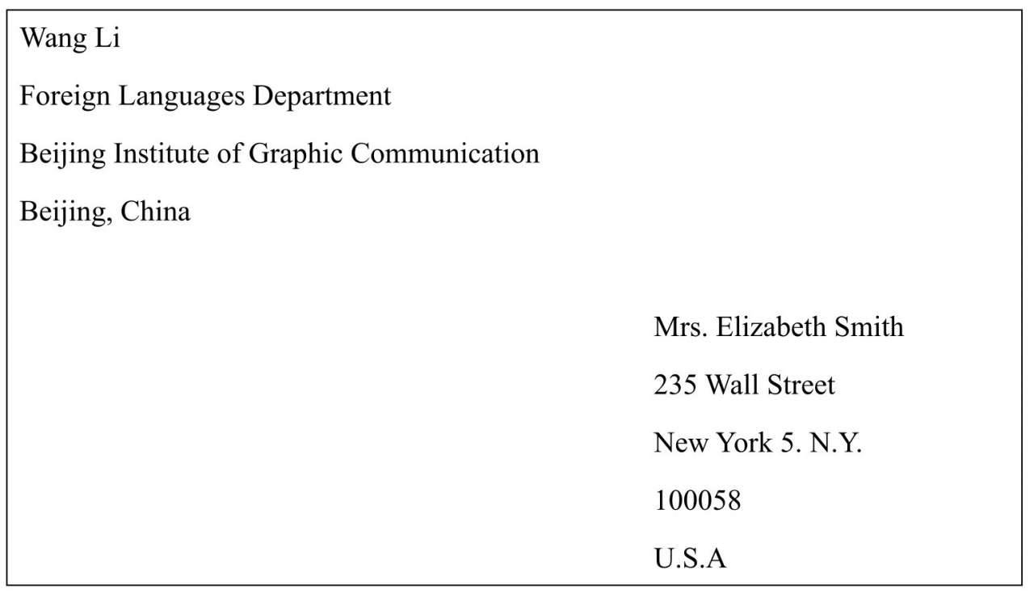
The Format of Letters
Lay-out of Envelops
考试要点
地址由小到大
收件人和发件人位置
中文地址翻译成英文
杭电英文地址地址
Stamp
发件人
收件人

Slide 23
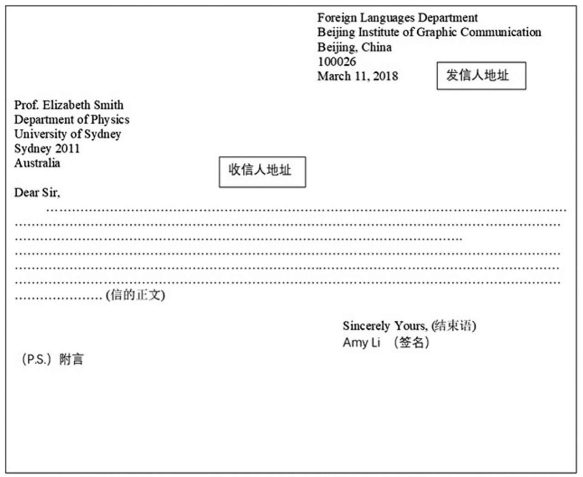
Lay-out of Business Letters

Slide 24
1. Even if the monk can run away, his temple cannot run with him. 跑得了和尚，跑不了庙。
2. Even if I were to be beaten to death, I will not tell.
打死我也不说。
3. Modesty helps one go forward, whereas conceit makes one lag behind. 谦虚使人进步，骄傲使人落后。
4. If winter comes, can spring be far behind?冬天来了，春天还会远吗?
5. We will not attack unless we are attacked.人不犯我，我不犯人。
6. Wisdom prepares for the worst; but folly leaves the worst for the day it comes. 聪明人防患于未然，愚蠢者临渴掘井。
7. In the end things will mend. 车到山前必有路。

Slide 25
8.To die on one's feet is better than to live on one's knees.
好死不如赖活。
9.Blood is thicker than water. 血浓于水。
10.He who laughs last laughs best.
谁笑到最后，谁笑得最好。
11.Give knaves an inch and they will take a yard.
得寸进尺。
12.He that respects others shall likewise be respected.
敬人者，人恒敬之。
13.All good things come to an end. 天下无不散之筵席
14.Give a dog a bad name and hang him.欲加之罪何患无词。

Slide 26
15.Nothing venture, nothing have. 不入虎穴，焉得虎子。
16.Do in Rome as the Romans do. 入乡随俗。
17.Things done cannot undone. 覆水难收。
18.Misfortunes never come alone. 祸不单行。
19.Beauty is in the eyes of the beholders.情人眼里出西施。
20.Time and tide wait for no man. 时不我待
21.Kill two birds with one stone.一石二鸟，一箭双雕。
22.Facts speak louder than words. 事实胜于雄辩。
23.To be a parrot 鹦鹉学舌;人云亦云
24.Fish in troubled waters 浑水摸鱼
25.Turn a deaf ear to 置若罔闻
26.A drop in the ocean 沧海一粟
27.Like father like son 有其父必有其子

Slide 27
28.Strike while the iron is hot. 趁热打铁。
29.As strong as a horse 强壮如牛
30.Love me, love my dog 爱屋及乌
31.A dog with two tails 非常高兴，兴高采烈
32.After a storm comes a calm. 否极泰来。
33.Hang by a thread 千钧一发
34.Break a deadlock 打破僵局
35.After a storm comes calm 雨过天晴
36.Cast pearls before swine 对牛弹琴
37.Hit the right nail on the head 击中要害
38.Rack one’s brains 绞尽脑汁
39.Leave no stone unturned 千方百计

Slide 28
唐朝(the Tang Dynasty)是普遍公认的中国最辉煌的时期之一。唐朝时期许多领域得到了巨大的发展。唐朝的疆域在军事扩张下已超过了汉朝(the Han Dynasty)。农业和灌溉工具有了很大的进步，农业经济十分发达。在商业上，唐朝与更多国家有了贸易往来。唐朝也是文学和艺术的黄金时期。盛唐时期出现了整整一代文学巨匠，其中包括唐诗“双圣”李白和杜甫。

Slide 29
The Tang Dynasty is universally recognized as one of the most glorious periods in China. It has seen great progress in many fields. The territory in the Tang Dynasty, acquired through military expansion, was greater than that in the Han Dynasty. Great advances have been made in agriculture and irrigation tools, making a prosperous agricultural economy. In business, the Tang Dynasty had trade contacts with more countries. The Tang Dynasty was also the golden age of literature and arts. In the high tang period, there appeared a whole generation of literary giants including LiBai and Du Fu, the twin masters of Tang poetry.

Slide 30
四六级翻译|中国朝代
中国有4000多年的历史，是世界最古老的文明之一。从公元前21世纪的夏朝开始至清朝结束，中国历史上经历过几十个朝代的变更。每个朝代在政治、经济、文化、科技领域等都有独特的成就。汉朝是当时世界上最先进的帝国。”汉族“（the Han Nationality）这一名称就得名于汉朝。唐朝因统一时间长、国力强盛而被国人铭记，因此在海外的中国人自称为“唐人”（Tang people）。宋朝和明朝是经济、文化、教育与科学高度繁荣的时代。但朝代的更替一般会导致连年战争，给人民大众带来了难以言表的痛苦。

Slide 31
With a history of more than 4,000 years,China is one of the oldest ancient civilizations of the world. From Xia Dynasty in the 21st century BC to Qing Dynasty, China experienced dozens of dynasties in history. Each dynasty achieved unique accomplishments in the fields of politics, economy, culture, science and technology, etc. Han Dynasty was the most advanced empire at that time, which contributes to the formation of the name "the Han Nationality . Tang Dynasty impressed Chinese for its long time unification and powerful national strength, because of which overseas Chinese call themselves "Tang people" abroad. Song Dynasty and Ming Dynasty were periods when economy, culture, education and science were highly prosperous. But the change from one dynasty to another usually led to long-lasting wars, which brought unspeakable suffering for the masses.

